Slide 1

Salesforce Developer Internship
Name : Likhitha Tanguturi
RoolNo : 20121A05R5
Branch & Section : CSE D

Slide 2
Internship Organization, Mode & Location
Internship Organization : Smart Internz
Mode : Online
Location : Tirupati

Slide 3
Role or Internship Training Undertaken
Salesforce Developer

Slide 4
Activity undertaken in Internship(More than one slide)
1.Master the Fundamental Concepts of Salesforce:
Salesforce Fundamentals:
This module help in how to consider different scenarios while developing an application in a multi-tenant environment.
This helps to understand how to use the MVC pattern to map the features of salesforce in it and also helps to learn to use the core CRM objects to build a schema in Salesforce.

Slide 5
2.Identify the Areas of Improvement
Good preparation requires a lot of practice, which you can do by giving mock tests.
attempting mock tests will help you to identify the areas where you need to improve. Once you identify the areas, you can focus more on those while you prepare for the Salesforce Developer certificate.
3. Working on a Demo Project:
Projects are the best means of learning because they involve implementing all the skills that you have acquired during learning process.

Slide 6
4.Improve Yourself through Self-assessment
Self-assessment is the best way to track our preparation and get the metrics for improvement.
By attempting mock tests and working on a project, I can identify the areas where I need to improve.
I can do a self-assessment of whether I am ready to get a good score in the Salesforce Developer certification or you still need to work harder.

Slide 7
Technology Used
The cloud computing service that specially looks into Customer Relationship Management is called Salesforce.
The cloud platform used in salesforce technology is Software as a Service(Saas). This helps in connecting with existing and future customers and partners in business.
The relationship with the customers can be maintained well with this technology, and new customers can be created.
The platform integrates all the domains such as marketing, sales, customer service, supply chain, data analysis, and many others so that customers can have an integrated view of the business

Slide 8
The Salesforce Technology used:
Apex:
Apex is a programming language similar to Java, used to develop and enhance the Salesforce CRM application.
It is used to access data from the CRM’s database and manipulate it as well by using an API (application user interface).
Developers also use it to customize and personalize the application as per the requisites of the business. It is very easy to control and execute flow, add business logic, trigger various events, etc., by using simple stored procedures.

Slide 9
Visual force:
Salesforce CRM uses Visualforce to create custom interactive user interfaces (UI) for mobile and web apps.
It is similar to HTML and uses tags just like any other Mark-up language.
It is very easy to learn and execute and helps in enhancing the look and feel of mobile and web apps in Salesforce technology.

Slide 10
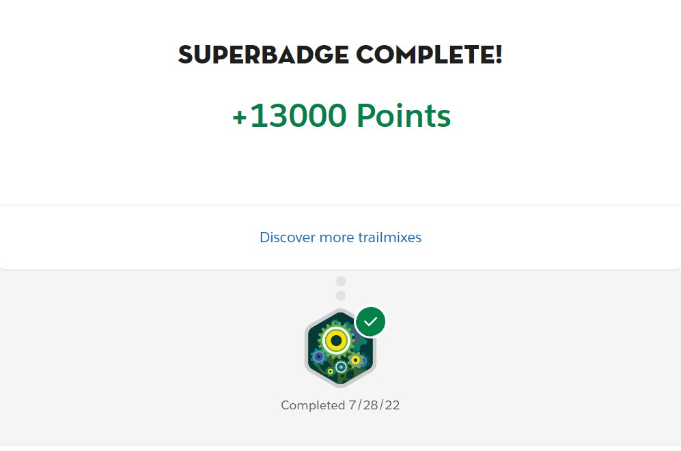
Screen shots:
Apex Specialist Super Badge:

Slide 11
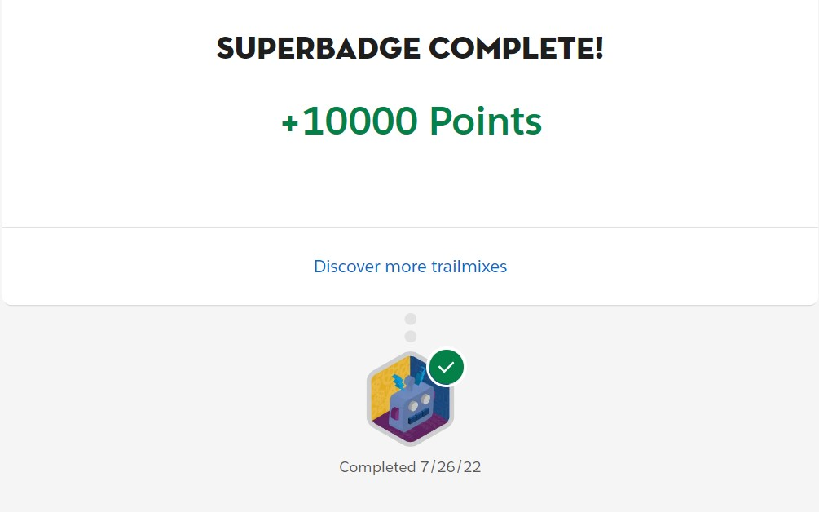
Process Automation Super Badge:

Slide 12
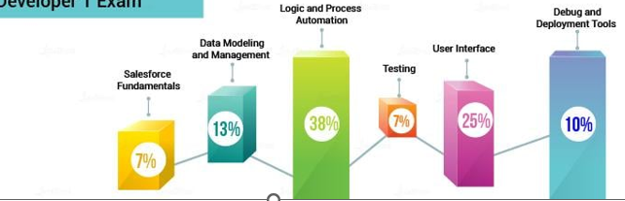
Important Learning

Slide 13
Salesforce Fundamentals(7%):
This module help in how to consider different scenarios while developing an application in a multi-tenant environment.
This helps to understand how to use the MVC pattern to map the features of salesforce in it and also helps to learn to use the core CRM objects to build a schema in Salesforce.

Slide 14
Data modeling and management (13%):
Data modeling is one of the important topics in the Salesforce Developer syllabus, where I will have to learn to design a data model according to the requirements.
It also helps me need to understand the schema design, the types of relationships for data modeling, the import and export of data, etc.

Slide 15
Logic and process automation (38%):
Logic and process automation is the heart of the salesforce automation processes.
this section has a 38 percent weightage, which is higher than the weightage of all other modules; so, you may have to be more alert when you are covering this module.
you have to understand how to use programming capabilities to design the object schema, create the formula fields and roll-up summary, and use the automation tools.

Slide 16
We should also learn the concepts related to Apex programming such as:
Variables and constants
Data types
Control flow statements
Classes and interfaces
Apex triggers and transactions
Exception handling
Apex custom controllers
Standard Visualforce controllers

Slide 17
User interface (25%):
Here you have to learn how to expose the data of a company by using a Visualforce page.
we must understand the mechanism of the lightning framework.
We will have to learn about the different types of content that you can combine by using the Visualforce page. You should also go through the resources that are incorporated with the Salesforce lightning components.

Slide 18
Testing (7%):
Testing is a crucial part of application development as it gives you information about the performance of an app.
In this module, we have to learn about the testing frameworks along with knowing how to write unit tests for various classes, controllers, and Apex triggers.
Further, you have to understand the multiple origins of the test data.

Slide 19
Debug and deployment tools (10%):
This section has a 10 percent weightage in the Salesforce Developer certification
As debugging is a key task while developing a full-fledged application, you have to learn about the various types of debug logs.
We should also know how to use the Developer Console and Workbench to develop and deploy a secured application.
Besides, We will have to learn how different environments and processes are used to build and deploy apps.

Slide 20
Challenges
Understand Objects Relationship:
It is essential to understand the relationship between objects in Salesforce and external systems.
Because while syncing data between the systems you would be selecting the right object in Salesforce for a relative object in an external system like selecting standard or custom object in Salesforce.

Slide 21
2. Duplicate Records:
Duplicate records are a challenge faced by all companies that lead to bad data. It’s important that you have a system that identifies and limits the entry of duplicate data during integration.
When importing custom objects, solutions, or personal accounts, you can use external IDs to prevent the import from creating duplicate records. An external ID is a custom field that has the External ID attribute, meaning that it contains unique record identifiers from a system outside of Salesforce.
When you select this option, the import wizard detects existing records in Salesforce with external IDs that match those values in the import file.

Slide 22
Promoting Bad Data:
Propagating bad data into Salesforce from an external system is not good.
If the external system pushes old records or unnecessary information into Salesforce, it will result in data duplication.
It is essential to remove obsolete data and cleanup systems in external systems before integrating with Salesforce.
we have other ways to avoid the creation of duplicate records in Salesforce which always counted against additional efforts – like, leverage Salesforce Out-of-the-box features like “Duplicate Management” or a piece of code.

Slide 23
Choosing Right Apps on AppExchange:
It is imperative to identify the right application from AppExchange (Free/Licensed) that meets your business needs, for Salesforce integration.
Choosing the right app will reduce Salesforce development efforts and save your team’s time and effort.
If none of the apps satisfy your set of requirements, it is suggestable to build your integration.
Also, apps available on AppExchange are available as managed/unmanaged packages. Please note that you can make changes to the unmanaged package and not to managed packages.

Slide 24
Data Validation:
Data validation is one of the key aspects while populating the data from an external system to Salesforce. Especially when you are filling data into Salesforce standard objects.
E.g., to create a contact in Salesforce the field the last name is mandatory, and the record will be successfully updated only when these mandatory fields are populated. All the contacts from the external system should satisfy the validation criteria to sync the data into Salesforce. The same validations apply to all custom objects too.
it should be noted that some fields may be mandatory in Salesforce but optional in external systems.
So, it is essential to understand the impact of any changes done at the data validation level.

Slide 25
Learning Outcomes:
It helps to describe the key features of salesforce technology using different programming languages
It able to explain Salesforce concepts such as the testing framework.
Identify common use cases for declarative verses programmetic customization.
Use Programmetic techniques to prevent security vulnerabilities.
It helps how to write the Apex classes and Triggers.
It helps to obtain modern salesforce programming skills.
Gain Knowladge and get certified on different technologies into Programming, Testing and Report customization.

Slide 26
Build up different data model or frame work using different technics and Automation.
It helps to obtain professional / skilled certification in different programming languages and also upgrade using different technologies.
Learn to make programmatic customization using Apex and get a solid foundation to become salesforce platform developer.
This helps to gain Knowladge about salesforce from scratch.
A salesforce developer helps to builds functionality using tools like Apex and visualforce and frameworks like lightning components in a sandbox before handing it over to the administrator to schedule deployment.
Helps to build Build functionality and system Integration and Testing and Change control.
Helps in gaining the knowledge and experience of developing a working functionality using some kind of platform and some code.

Slide 27
It help me in covering basic salesforce technology functionality utilizing several programming languages.
It taught how to use programmable strategies to minimize security flaws and how to write classes and triggers in Apex.
I gain the knowledge on how to develop various data models or architectures employing various techniques and automation.
It helps in comprehension of many technologies development,validation,and report modification by the end of this training.
Gains Knowledge of data modelling, data security , Apex triggers,and classes and validation methodologies as well as Apex Integration services skills.
Customize apps using formulas and validation rules, as well as build business process models utilizing process builders and flows.

Slide 28
References(if any)
https://www.forcetalks.com/blog/sales-cloud-in-salesforce-all-about-it/
https://www.forcetalks.com/blog/oauth-2-0-client-credentials-flow-salesforcedeveloper-guide/
https://www.forcetalks.com/blog/salesforce-crm-implementation-challengesand-solutions/
https://www.forcetalks.com/blog/managed-services-the-go-to-model-forsalesforce-users/
https://www.forcetalks.com/videos/data-migration-salesforce-admin-tutorial/
https://www.forcetalks.com/videos/salesforce-salaries-in-current-market/
https://www.forcetalks.com/videos/is-salesforce-career-recession-proof/
https://www.forcetalks.com/videos/validation-rules-in-salesforce-video-tutorialguide/
https://www.forcetalks.com/blog/user-agent-flow-in-salesforce-the-developerguide/
https://www.forcetalks.com/blog/top-5-ways-salesforce-cdp-solves-customerdata-challenges-and-benefits-business-growth/

Slide 29
Thank you

